Slide 1
Optimizing Hotel Room Pricing for Azure Hotels
Data Science Case Study
Prepared By: Ankit Choudhary
Date: 08/09/2024
Link- Collab

Slide 2
Executive Summary
Problem Statement:
Azure Hotels seeks to optimize its room pricing strategy to maximize revenue and profitability.
Key Insights:
City hotels are more popular (61.1%) than resort hotels (38.9%).
72.5% of all bookings are canceled.
Online TA market segments dominate the booking landscape.
Recommendations:
Implement dynamic pricing strategies based on customer segments.
Focus on reducing cancellations for maximum profitability.
Apply segmentation to better cater to customer categories like transient and TA/TO bookings.

Slide 3
Overall Analytical Approach/Architecture
Data Preprocessing:
Removed duplicates (31,994 entries) and handled null values (agent, children, country, company).
Feature extraction: created new features like total stays, total people, total childrens,
reserved room assigned.
Removed outliers from lead time and ADR.
Categorical conversion for lead time and guest categories.
Modeling Approach:
Implemented linear regression for pricing drivers and pricing strategy.
Used k-means for customer segmentation.
Evaluation and selection of best models through hyperparameter tuning.

Slide 4
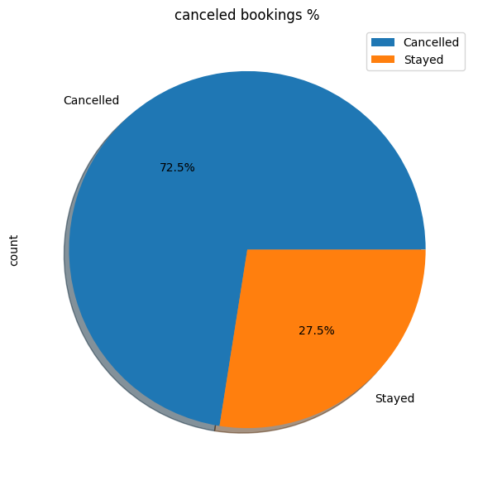
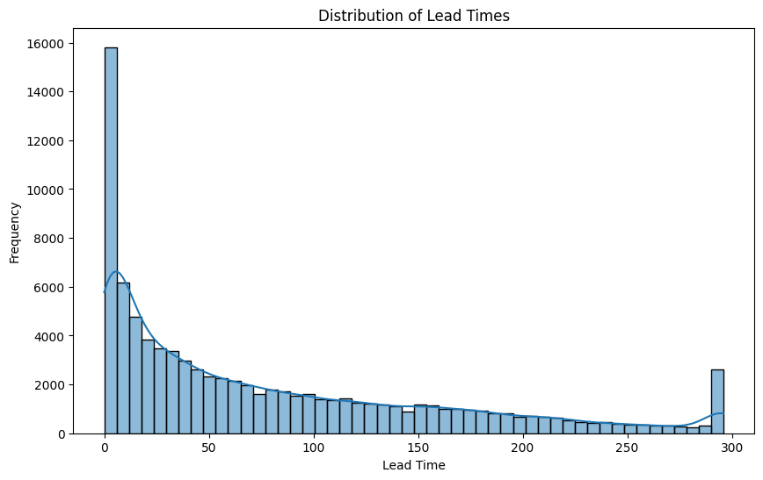
Eda Findings

Slide 5
Customer Segment Analysis and Profiling
Key Segments:
Majority of bookings are made through transient customers (82.4%) and TA/TO market segment (59.1%).
Customers from PRT, GBR, and FRA show higher cancellation rates.
Segmentation Techniques:
Model Used:
K-means clustering (best performing).
Created clusters based on customer behavior.
Profiled customers based on preferences for city vs. resort hotels, cancellation behavior, and lead time.

Slide 6
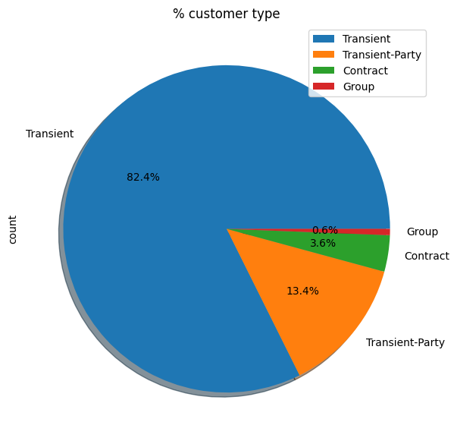
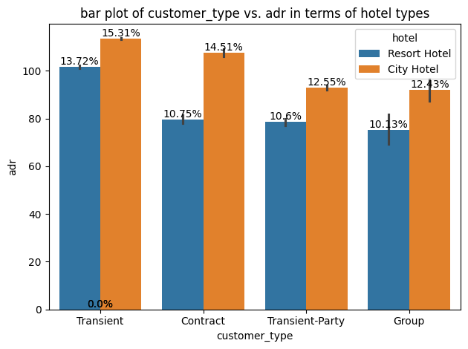
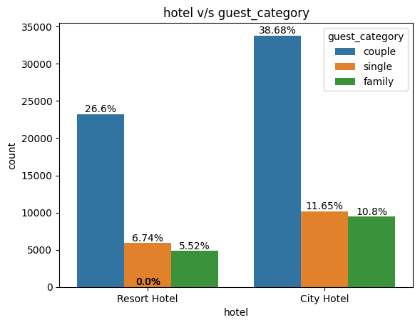
Customer Segment Charts

Slide 7
Pricing Drivers Identification and Analysis
Key Pricing Drivers:
Factors affecting room pricing: hotel type, customer segment, distribution channels, booking lead time.
Average Daily Rate (ADR) was higher for room types C, F, G, H.
Room cancellations significantly impacted pricing strategies (non-refundable categories had the most cancellations).
Modeling Techniques:
Model Used:
Linear regression (best performing).
Identified correlations between ADR and variables such as total stays, room type, and guest category.

Slide 8
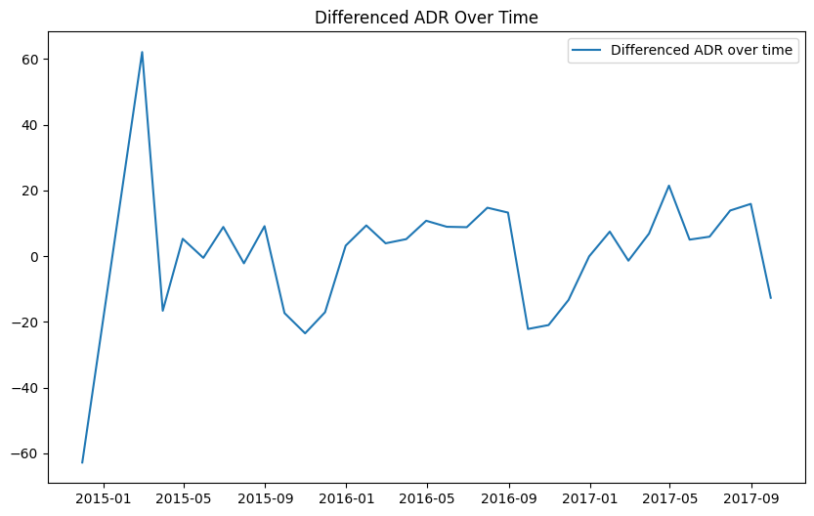
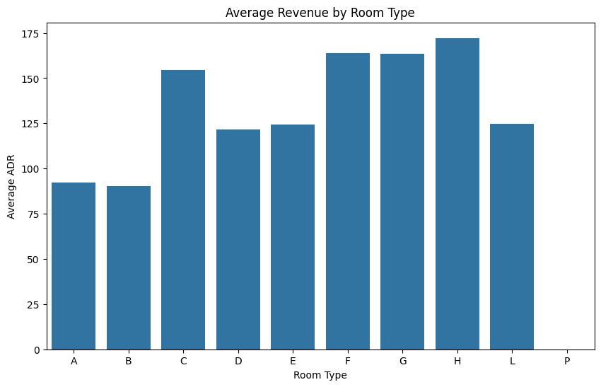
Pricing Charts

Slide 9
Recommended Pricing Strategy and Expected Impact
Pricing Strategy:
Dynamic pricing based on customer segments and lead times.
Adjust pricing to minimize cancellations (e.g., adjusting non-refundable rates and focusing on booking channels with lower cancellation rates).
Seasonal demand and competition-based pricing.
Forecasted Impact:
Expected revenue increase by better targeting high-value customer segments.
Revenue from transient customers expected to rise by optimizing short-term stay pricing.
Modeling Techniques:
Model Used:
Linear regression for demand forecasting and pricing strategy.

Slide 10
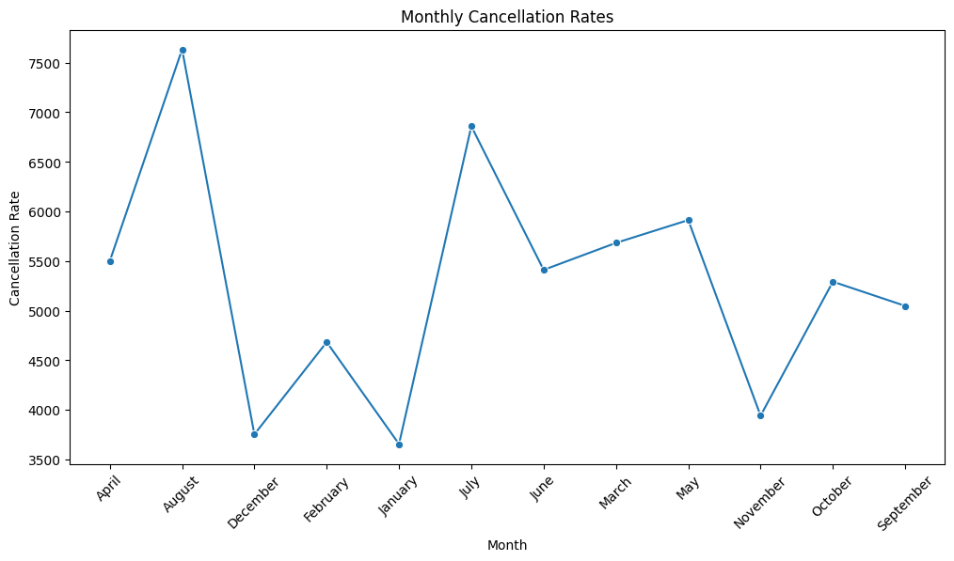
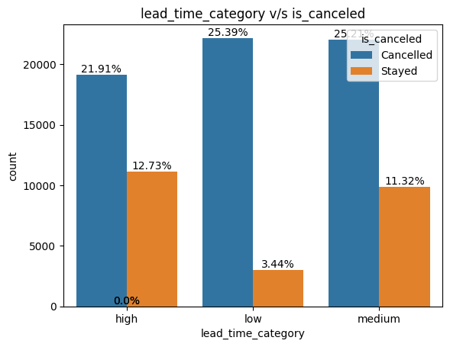
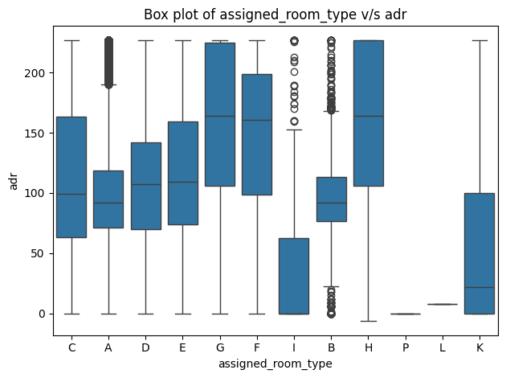
Pricing Charts

Slide 11
Impact Quantification
Revenue Impact:
City hotels generate 54.86% of total revenue, with a strong focus on transient customers.
Resort hotels and luxury room categories (G, H) offer higher ADR and potential revenue.
Demand forecasting models predict stable demand across peak months.
(October, December) for resorts and (May, September, October) for city hotels.
Profitability Analysis:
Reduced cancellations during low-demand months (November-February) will stabilize profits.
Seasonal pricing adjustments will lead to 10-15% expected increase in revenue.

Slide 12
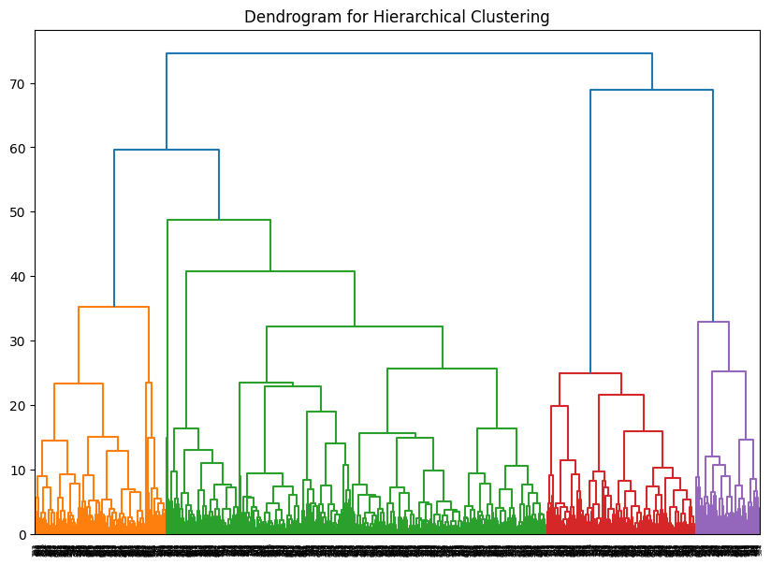
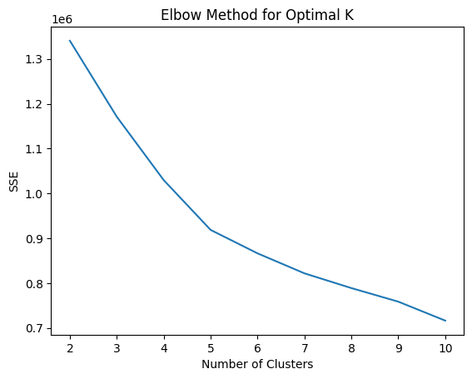
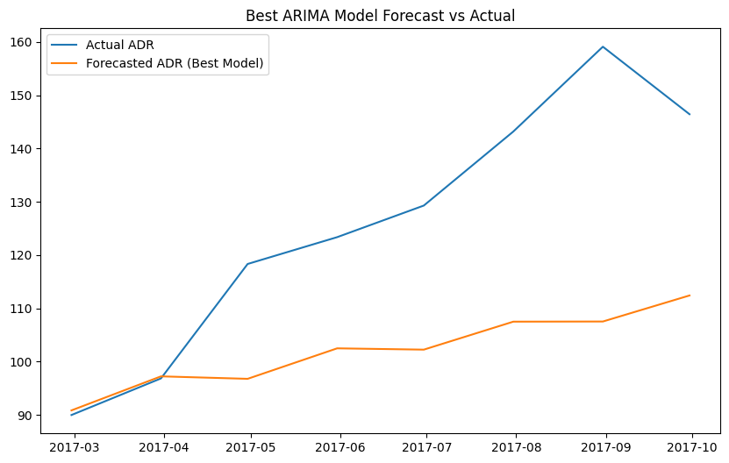
ML Models

Slide 13
Conclusion and Next Steps
Conclusion:
Effective segmentation and pricing strategies can significantly enhance Azure Hotels’
profitability.
The identified pricing drivers should guide dynamic pricing models.
By focusing on reducing cancellations and optimizing high-demand rooms,
the overall revenue is expected to increase.
Next Steps:
Deploy machine learning models for real-time pricing in a production environment.
Continuously monitor and adjust pricing models based on customer behavior and demand trends.
Implement a customer feedback loop to refine pricing strategies.
End.

